Slide 1
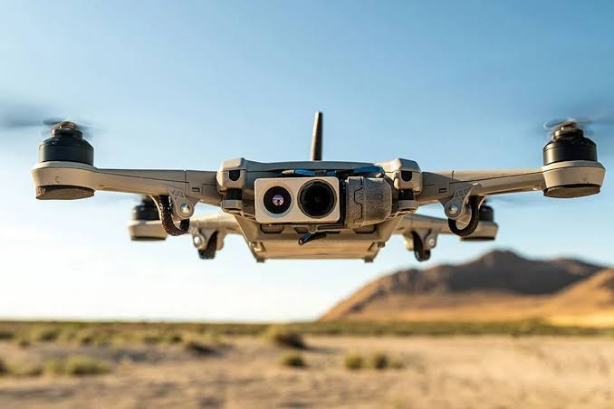
DRONE KE NIYAM
&
DO’S & DON’TS

Slide 2


INTRODUCTION

Slide 3
AIM
SCOPE
PHASE I - RULES
PHASE II - DO’S & DON’TS

Slide 4
PHASE I - RULES

Slide 5

DGCA RULES
Unmanned Aerial System (UAS) Rules, notified in Mar 2021
Aim:
  Digital sky platfrom me kam se manav interface karna.

Slide 6
PRAVDHAN
PRAVDHAN
  Fee kam se kam level tak gataya jaye. Iska drone ke size ke sath koi sambandh nahi
  Bibhin Approval ki avashkta ko samapt karna. Anurupta ke praman patra, rakh-rakhav ka praman patra, certificate of maintenance, majauda drone ki aayat manjuri, operator permit, authorisation of R&D organisation and student remote pilot licence.

Slide 7
PRAVDHAN
DIGITAL SKY PLATFORM.
  Ek digital sky platfrom viksit kiya ja raha hai jismein interactive airspace map desh ko green, yellow aur red area zone mein bantega.
  Yeh ek surakshit aur scalable platform pradan karega, jo drone technology frameworks ko samarthan karta hai, jaise (koi anumati nahi ,koi take off nahi)
  Jatayat ko kushalta purvak aur udaan anumati ko digital rup se saksham karne ke liye design kiya gaya.

Slide 8
KEY PTS
Reduced Airport Perimeter.
  Majauda niyamo ne airport ki dairya 45 km se ghata kar 12 km kar diya .
  Niyam mein bataya gaya ki green zone mein 400 feet tak aur airport ke perimeter mein 8 se 12 km ke bich ke aera mein 200 fit tak udan bahrne ke liye anumati ki jarurat nahi hogi ..

Slide 9
KEY PTS
Pilot License.
  Non commercial use ke liye micro drone, Naino drone aur R&D organisation ke liye kisi pilot license ki jarurat nahi hogi .
  Bharat mein registered company dwara drone sanchalan per koi pratibandh nahi hoga .

Slide 10
KEY PTS
Drone Corridor. Defense department delivery ke liye drone corridor ke vikas ki suvidha bhi dega aur business ke anukul suvidha ke liye ek drone promotion council ki sthapana ki jayegi .
Safety Features. Majauda niyam mein real time tracking beacon aur je0-fencing jaisi suraksha ka pravdhan hai jinhe future mein notified kiye jane ki ummid hai aur anupalan ki liye 6 month ka samay diya jayega.
Increased Coverage of Drones: Coverage ko 300 kg se badhakar 500 kg kar diya gya hai aur drone taxis ko cover karega jabki udan yogata praman patra jari karne ka kaam quality council of india aur iske dwara authorised pramapan sansthayon ko diya gya.

Slide 11
PHASE II - DO’S & DON’TS

Slide 12
DO’S
Sunischit karen ke aap ka Drone (50 feet tak ki uncontrolled hawai khestra mein naino ko chhodkar ) digital sky no permission–no take off ke anurup hai.
Control hawai khestra ( ATC siwayein sakriya hai) mein sanchalan ke lie DGCA se vishisht pahchan sankhya (UIN) prapat karen aur apne dronepar lagayen.
Commercial operation ke liyere DGCA lagu hone par Unmaned aircraft operator permit (UAOP) prapat karen aur sambhal kar rakhen.

Slide 13
DO’S
1 Dec 2018 se DGCA ki website par ublabdh digital sky plateform ke madhyam se pretek udhaan se pahle anumati prapat karen.
Hastkshep par nazar rakhen jo mobile upkarnon ya sanketon ke avrodh se ho sakta hai.
Kewal din ke ujale ke dauran (sunrise ke baad aur sun set se pahle ) udhaan bharen.
Achchhe mausam mein udhaan bhare. Achchha mausam aapko na kewal apne drone ko behtar tarike se udhane deta hai balki hawa mein bhi iska track rakhta hai.

Slide 14
DO’S
Fly in visual line of sight (VLOS).
Hawai khestra pabandhiyon/Drone zone nahi hone se avgat rahen aur logon ki privacy ka samman karen.
Apne drone udhaan gatividhi ke bare local police ko suchit karen.
Agar police aapse sampark karti hai to usko paryapat jaankari pradan karen.
Apni udhaan ko login karen aur kisi ghatna/durghatna ke bare mein sambandhit adhikariyon (jaise DGCA , Local police) ko suchit karen.

Slide 15
DO’S
Fly in visual line of sight (VLOS).
Hawai khestra pabandhiyon/Drone zone nahi hone se avgat rahen aur logon ki privacy ka samman karen.
Apne drone udhaan gatividhi ke bare local police ko suchit karen.
Agar police aapse sampark karti hai to usko paryapat jaankari pradan karen.
Apni udhaan ko login karen aur kisi ghatna/durghatna ke bare mein sambandhit adhikariyon (jaise DGCA , Local police) ko suchit karen.

Slide 16
DON’TS
Nano drone ko jamini level se 50 feet se upar na udhayen.
Jamini level se 200 feet se upar micro drone ko na udhayen.
Jamini level se 400 feet se adhik uchai par drone na udhayen.
Other aircraft (Manned aur Unmaaned) ke paas drone na udhayen.
No fly zone mein drone na udhayen.
Airport aur heliports ke paas drone na udhayen.

Slide 17
DON’TS
Logon ke gp, public place ya stadium par drone bina anumati ke na udhayen.
Govt facility/Sainik bases ke paas drone na udhayen.
Jab tak anumati na di jaye niji sampati par drone na udhayen.
Udhan yojana dakhil keye bina airport ke pass drone na udhayen.
Heavy saman drone se na lekar jaye na hi girayen.
Nashe ki halat mein drone na udhayen.
Chalte veh, Ship and aircraft se drone na udhyen.

Slide 18
JAI HIND

